Slide 1
8051-INTERFACING WITH DC MOTOR

Slide 2
DC MOTOR
A DC motor is widely used device that translates electrical pulses into mechanical movement .
In the DC motor, we have + and – leads
Connecting them to a DC voltage source moves the motor in one direction.
By reversing the polarity, the DC motor will move in opposite direction.

Slide 3
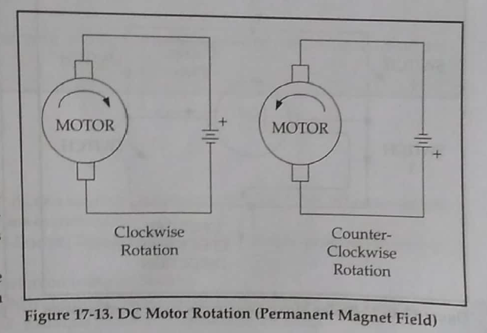
DC motor-Unidirection control
Figure 17.13 shows the DC motor rotation clockwise and counter-clockwise rotations

Slide 4
DC motor-Bidirection control
With the help of relays or some specially designed chips, we can change the direction of the DC motor rotations
Fig 17-14 through 17-17 shows the basic concepts of H-Bridge control of DC motors.

Slide 5
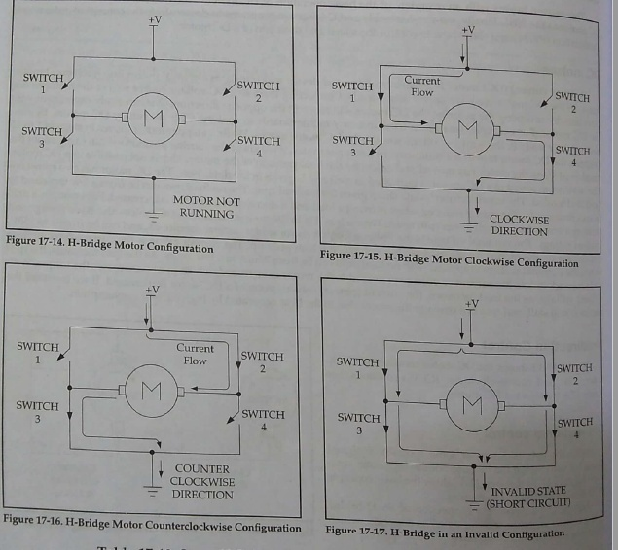
DC motor-Bidirection control

Slide 6
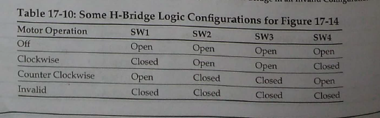
DC motor-Bidirection control

Slide 7
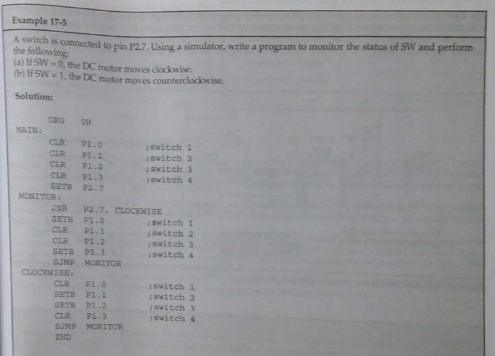

Slide 8
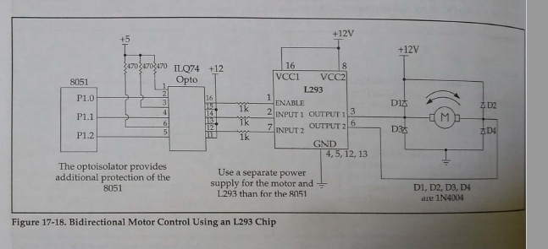
DC motor-Bidirection control

Slide 9
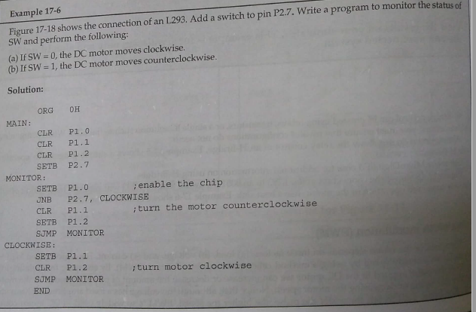

Slide 10
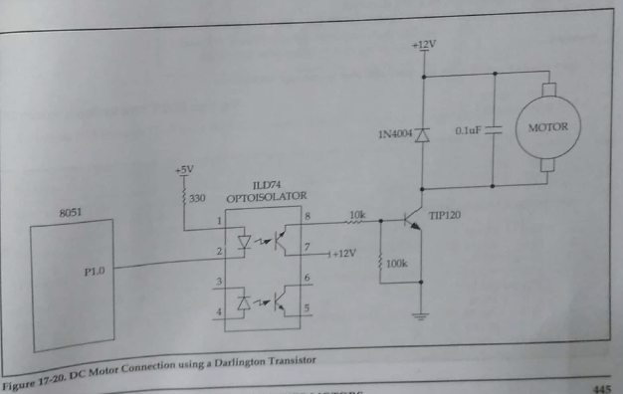
DC MOTOR WITH OPTO ISOLATOR

Slide 11
